Slide 1


Slide 2


ENGG 1500
lecture 1
27/02/2017

Slide 3

ENGG 1500
lecture 1
27/02/2017

Slide 4


Circa 1970
ENGG 1500
lecture 1
27/02/2017

Slide 5

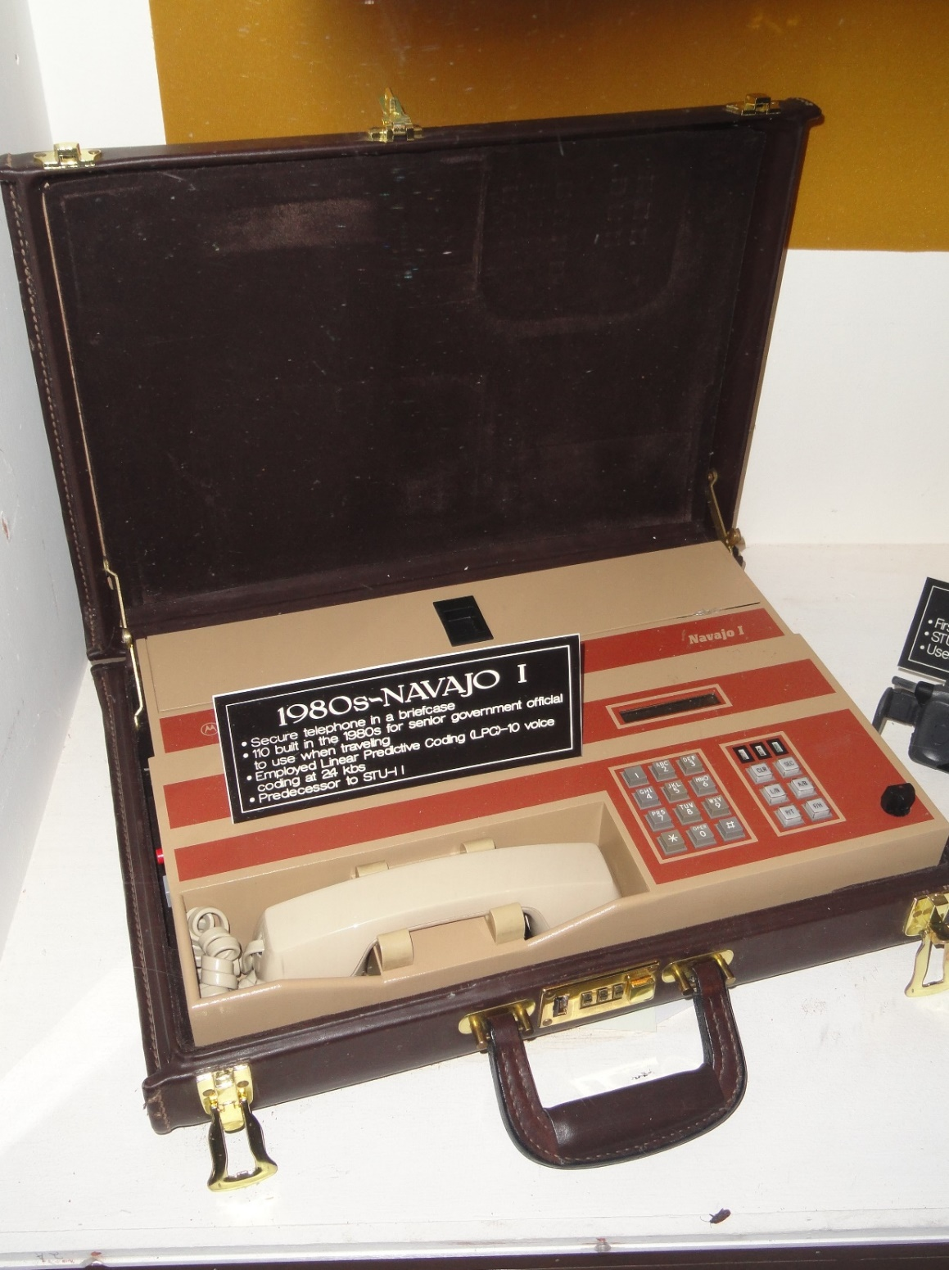
ENGG 1500
lecture 1
27/02/2017

Slide 6

ENGG 1500
lecture 1
27/02/2017

Slide 7

ENGG 1500
lecture 1
27/02/2017

Slide 8
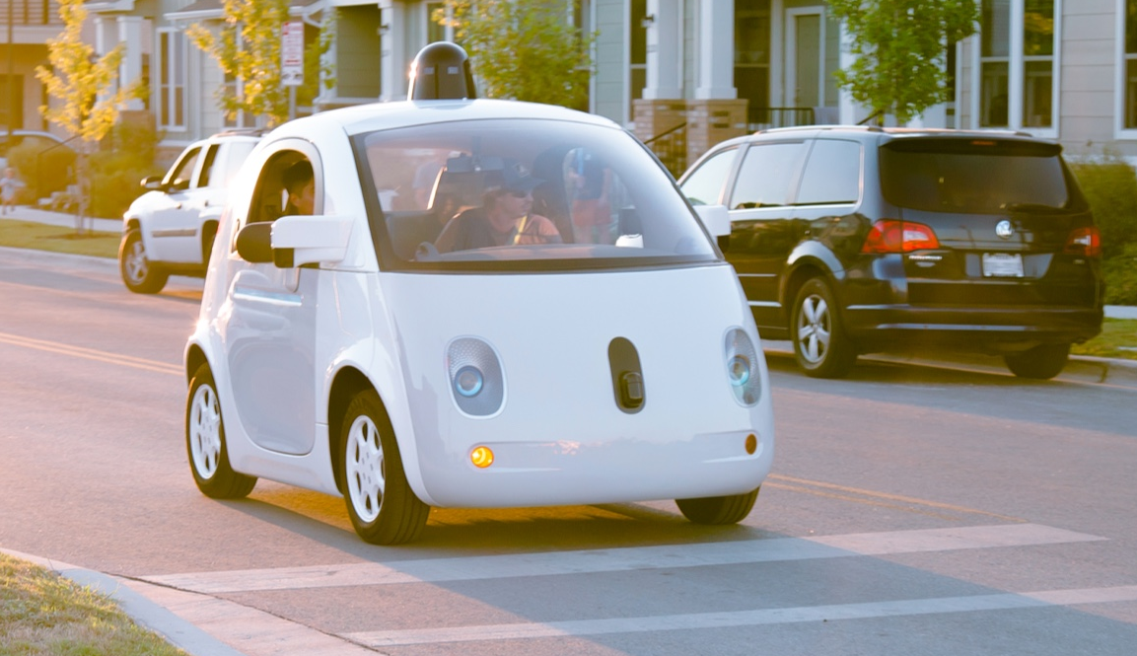
ENGG 1500
lecture 1
27/02/2017

Slide 9

ENGG 1500
lecture 1
27/02/2017

Slide 10
What’s next???
Well that’s going to be up to you
What are the next big challenges?
Sustainable energy
Smart systems
Mars
Medicine?
Brain science?
Engineers are problem solvers
I can’t do it, I'm too old
ENGG 1500
lecture 1
27/02/2017

Slide 11

ENGG 1500
lecture 1
27/02/2017

Slide 12
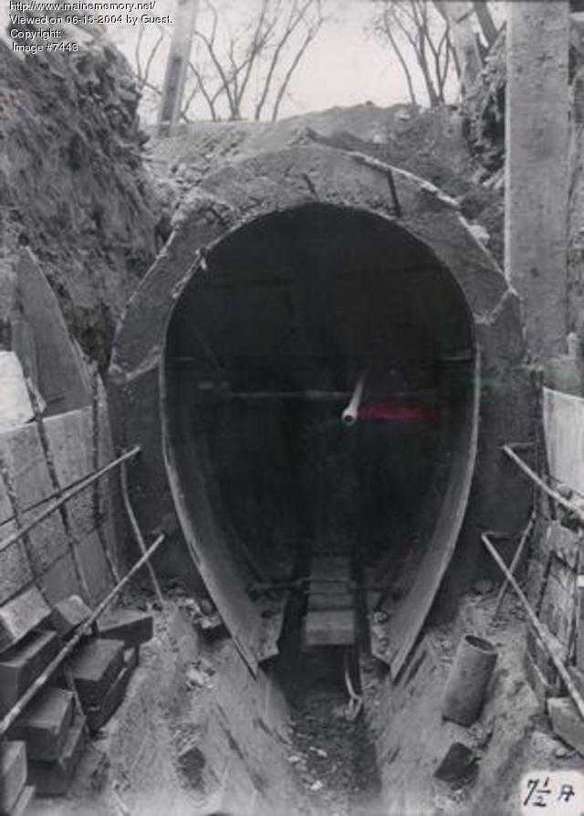
ENGG 1500
lecture 1
27/02/2017

Slide 13
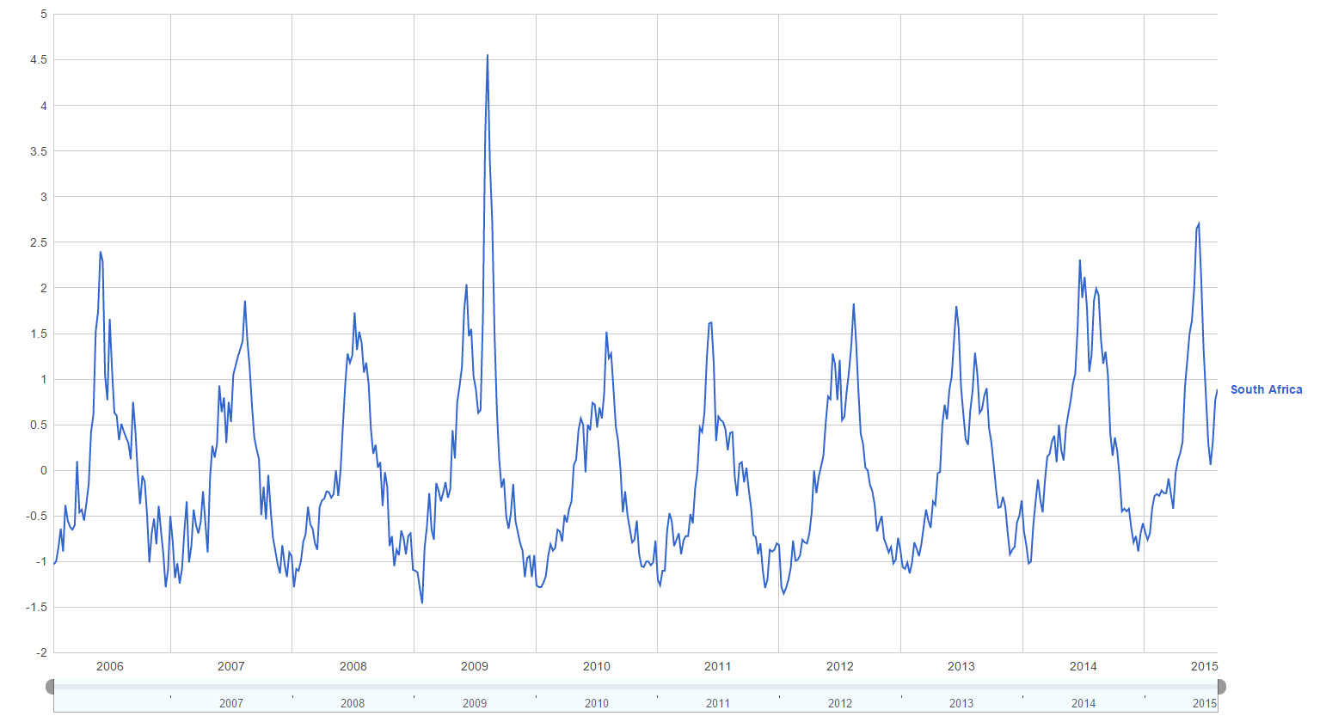
ENGG 1500
lecture 1
27/02/2017

Slide 14


Slide 15
The projects
Semi – autonomous vehicles
Micro wind turbine
Desalination devices
River crossing using augmented reality
Optimising structures via computer simulation
Mobile apps

Slide 16
By the end of this semester you will
Solve a problem
Communicate effectively
Work with peers
Understand engineering both as a whole and as a degree
Understand more about how university works
ENGG 1500
lecture 1
27/02/2017

Slide 17
How? By Doing!
At this stage you have no idea how to do it properly (you might think you do but you don’t)
If your scared, you should be
We will guide you through the process
Over the next 10 weeks you will work through the entire project using the engineering method to arrive at a tangible solution to the problem
You will need to be self driven, we are not going to give you the answer
ENGG 1500
lecture 1
27/02/2017

Slide 18
Your projects:
Intentionally open ended… That’s a real problems
Have many paths and many possible solutions
Have no clear answer
Steep learning curve
They all require research, planning, building, testing and evaluation
Targeted to a discipline but really interchangeable! You are here for the experience not the outcome
ENGG 1500
lecture 1
27/02/2017

Slide 19

Why am I doing this to you?
I want you to be capable of seeing a problem, you have no idea how to solve, and saying:
Learn new skills learn independently! The tutors will not tell you everything!
Depending on the project you may need to learn:
New software
Construction (or both)
Learn how things work
Underlying physical principles
Value add to the technical skills you are learning in other subjects
ENGG 1500
lecture 1
27/02/2017

Slide 20
ENGG1500 Classes:
Lectures:
From me
Talk about general engineering topics
Help you understand the projects
Workshops:
From experts in your discipline
For you to work on the project
Most important part
Tutorials:
For you to work on your project
Research/writing/ design
Enrolments!
ENGG 1500
lecture 1
27/02/2017

Slide 21
ENGG1500 is:
Problem based/ Self driven learning
Conceptual not heavily technical
Complimentary to your other courses
Board/ inclusive of external factors and disciplines
About the experience not the outcome
Brand new!
The first of 4 professional practice courses
ENGG 1500
lecture 1
27/02/2017

Slide 22
Difference between the engineering disciplines
Basically its all the same
Just different tools in your problem solving tool kit
We like to joke about it
Most useful in multidisciplinary teams
Not too different from science either
ENGG 1500
lecture 1
27/02/2017

Slide 23
Who am I?
I’m you… well I was 9 years ago
Mechanical engineering degree
Honours project investigating the synthesis of advanced ceramics by combustion reactions
PhD in material science
Dr Dylan Cuskelly
Published 10 papers
Presented at 2 International conferences
Research at Cambridge
ENGG 1500
lecture 1
27/02/2017

Slide 24

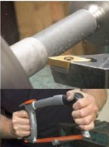
What do I do?
I make new materials in interesting ways
MAX phases – ceramics with metallic properties
Things for physics; brasses, purple gold, tungsten bronzes…
Miscibility gap alloys for renewable energy thermal storage
I also teach
Lecture GENG1000
Tutor for the last 5 years
Built ENGG1500 (with help)
ENGG 1500
lecture 1
27/02/2017

Slide 25

Why am I telling you this?
Lectures are all researchers first, and very good at it!
Newcastle university has produced some amazing research and collaborated with universities all over the world
Lecturers are not teachers
I am the least experienced lecturer you will have
ENGG 1500
lecture 1
27/02/2017

Slide 26
How do you find me?
I am Dr Dylan Cuskelly
Room: ES315
Email: dylan.cuskelly@newcastle.edu.au
Remember there are over 400 of you, Emails are important!
ENGG 1500
lecture 1
27/02/2017

Slide 27
This week you need to
Go to your workshop!
Read you project description (Look in the blackboard folder)
Do any OH&S required of you (PPE, Lab inductions)
Start researching
Don’t try to solve your problem yet! (next week)
ENGG 1500
lecture 1
27/02/2017

Slide 28
Introduction to University
Blackboard is the place that all your course material will go
Email is the communication method at university
Check it every day
‘I didn’t see the email’ is never an excuse
I get them on my phone
ECHO records lectures
For revision not replacement
ENGG 1500
lecture 1
27/02/2017

Slide 29
Assessments
Not like high school!
No syllabus, no dot points. We want to see you think!
No scaling. Help those around you, your peers are your life support
I can give everyone an HD or everyone a fail
Think 1 hr per 1 % (conservative for first year)
Worry more about what you learn then what mark you get!
Your course outline should give you information on assessments
Listen to your Workshop tutor, they may change things
There is a second assessment document to help you understand the assessments
ENGG 1500
lecture 1
27/02/2017

Slide 30
Tips for survival
This is advice not rules
What works for me might not work for you
Get help if you need it
Doesn't matter as long as you work hard!
ENGG 1500
lecture 1
27/02/2017

Slide 31

Data storage
Memory sticks = life these days
Make it easy for it to find its way home
Make a ‘read me’ file with sufficient details for someone to return it to you
I’m on a cloud
Dropbox, google drive, one drive
ENGG 1500
lecture 1
27/02/2017

Slide 32
Tips from previous Students
Basis - An informal questionnaire was to past students
What would you have liked to know in week 1?
Size of the workload (general Uni)
How to study well and how to structure my time.
That doing 4 subjects of 6 hours a week (i.e. 24 hours) plus at home study which was suggested 1 hour or more for every hour at uni = 48 hours. So it isn't really possible to have a part-time job and do well at uni.
I knew that engineering was going to be a lot of work but it would have been good if that was drummed into us somewhere.
Study and complete homework from week 1
Friends are useful
Pie shop
ENGG 1500
lecture 1
27/02/2017

Slide 33
How to send an email
Start formal
Make it clear
Think it through before you hit send
Check them regularly
ENGG 1500
lecture 1
27/02/2017

Slide 34
Final bits
If you have a problem – talk to someone.
Make sure it is the right person.
ENGG 1500
lecture 1
27/02/2017

Slide 35
Send in your questions
Next week I will be talking about survival strategies for university
Send in any and all questions you have
I will answer FAQ’s

Slide 36
ENGG 1500
lecture 1
27/02/2017

